Slide 1
COCOMO-II

Slide 2
COCOMO II
Includes
  COTS and reusable software
  Degree of understanding of requirements and architectures
  Schedule constraints
  Project size
  Required reliability
Three Types of models
  Application Composition - Prototyping or RAD
  Early Design - Alternative evaluation
  Post-architecture - Detailed estimates

Slide 3
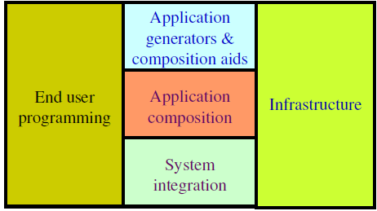
COCOMO-II
The following categories of applications projects are identified by COCOMO-II.

Slide 4
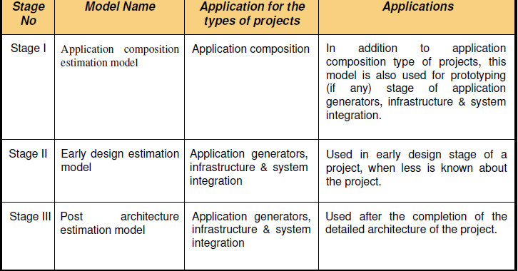

Stages of COCOMO II

Slide 5
Application Composition Estimation Model

Slide 6
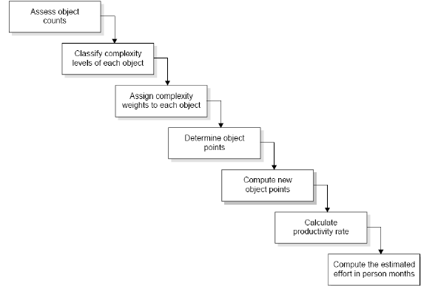

Slide 7
Assess object counts
  Estimate the number of screens, reports and 3 GL components that will comprise this application.
Classification of complexity levels
  We have to classify each object instance into simple, medium and difficult complexity levels depending on values of its characteristics.

Slide 8
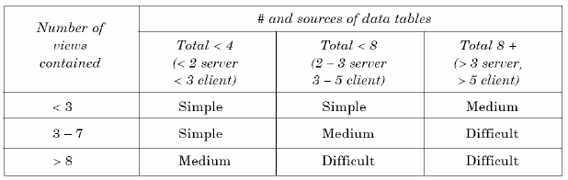
For screens

Slide 9
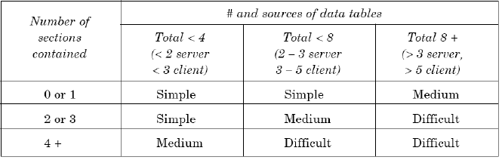
For reports

Slide 10
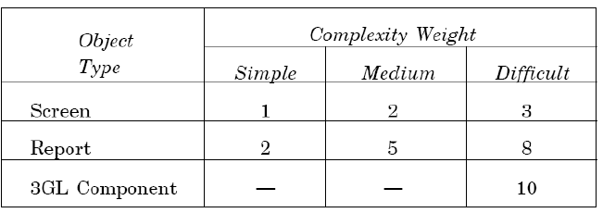
Assign complexity weight to each object
  The weights are used for three object types i.e., screen, report and 3GL components using the table.
Complexity weights for each level

Slide 11
Determine object points
  Add all the weighted object instances to get one number and this known as object-point count.
Compute new object points
  We have to estimate the percentage of reuse to be achieved in a project.
  Depending on the percentage reuse, the new object points (NOP) are computed.
  NOP are the object points that will need to be developed and differ from the object point count because there may be reuse.
(object points) * (100-%reuse)
NOP = -------------------------------------------
100

Slide 12
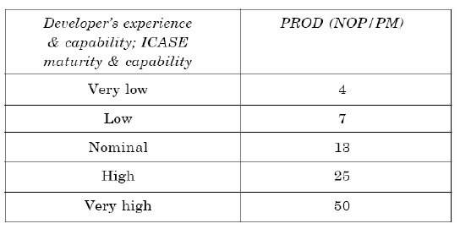
Calculation of productivity rate
  Productivity rate (PROD) = NOP/Person month
Productivity values

Slide 13
Compute the effort in Persons-Months
NOP
Effort in PM = ------------
PROD

Slide 14
Example
Consider a database application project with the following characteristics:
  I. The application has 4 screens with 4 views each and 7 data tables for 3 servers and 4 clients.
  II. The application may generate two report of 6 sections each from 07 data tables for two server and 3 clients. There is 10% reuse of object points.

Slide 15
  The developer’s experience and capability in the similar environment is low.
  The maturity of organization in terms of capability is also low.
  Calculate the object point count, New object points and effort to develop such a project.

Slide 16
Solution
This project comes under the category of application composition estimation model.
Number of screens = 4 with 4 views each
Number of reports = 2 with 6 sections each
From Table, we know that each screen will be of medium complexity and each report will be difficult complexity.

Slide 17
Using Table of complexity weights, it may calculate object point count.
= 4 x 2 + 2 x 8
= 24
NOP= 24*(100-10)/100=21.6
Effort in PM= NOP/PRODUCT =21.6/7=3.086

Slide 18
The Early Design Model

Slide 19

The Early Design Model
The COCOMO-II models use the base equation of the form:-
PMnominal= Effort of the project in person months.
A = Constant representing the nominal productivity, provisionally set to 2.5
B = Scale factor
Size = Software size

Slide 20
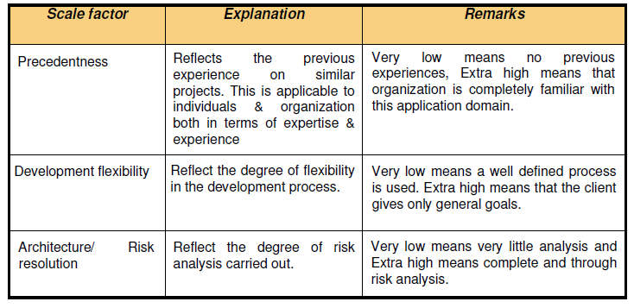
Scaling factors

Slide 21
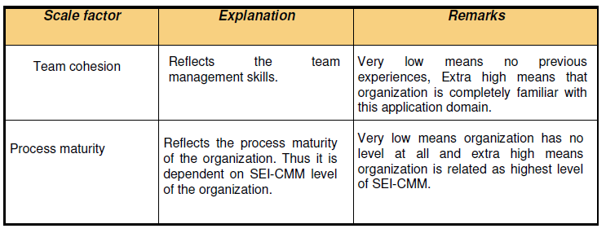

Slide 22
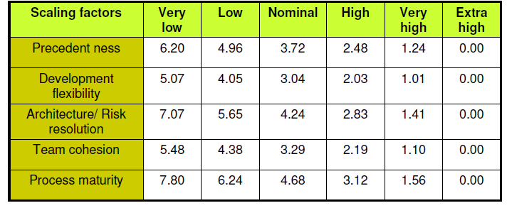
Data for the Computation of B
B=0.91 + 0.01 * (Sum of rating on scaling factors for the project)

Slide 23
Early design cost drivers
Seven early design cost drivers:
  i. Product Reliability and Complexity (RCPX)
  ii. Required Reuse (RUSE)
  iii. Platform Difficulty (PDIF)
  iv. Personnel Capability (PERS)
  v. Personnel Experience (PREX)
  vi. Facilities (FCIL)
  vii. Schedule (SCED)

Slide 24
Post architecture cost drivers
There are 17 cost drivers in the Post Architecture model.
These are rated on a scale of 1 to 6 as given below :

Slide 25
Seventeen Cost Drivers
The list of seventeen cost drivers is given below:-
  i. Reliability Required (RELY)
  ii. Database Size (DATA)
  iii. Product Complexity (CPLX)
  iv. Required Reusability (RUSE)

Slide 26
  v. Documentation (DOCU)
  vi. Execution Time Constraint (TIME)
  vii. Main Storage Contraint (STOR)
  Viii Platform Volatility (PVOL)
  ix. Analyst Capability (ACAP)
  x. Programmers Capability (PCAP)
  xi. Personnel Continuity (PCON)
  xii. Analyst Experience (AEXP)

Slide 27
  xiii. Programmer Experience (PEXP)
  xiv. Language & Tool Experience (LTEX)
  xv. Use of Software Tools (TOOL)
  xvi. Site Locations & Communication Technology
  between Sites (SITE)
  xvii. Schedule (SCED)

Slide 28
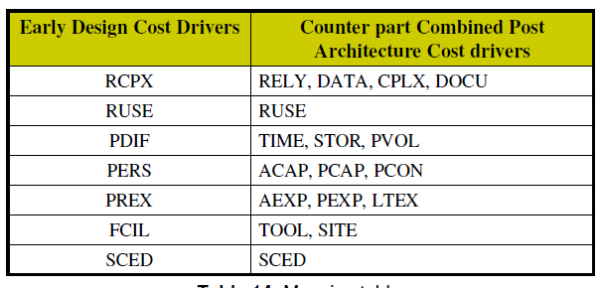
Mapping of early design cost drivers and post architecture cost drivers
The 17 Post Architecture Cost Drivers are mapped to 7 Early Design Cost Drivers and are given in Table.

Slide 29
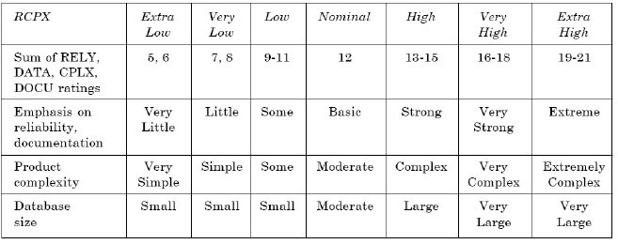
Product Reliability and Complexity (RCPX)
The cost driver combines four Post Architecture cost drivers which are RELY, DATA, CPLX and DOCU.

Slide 30
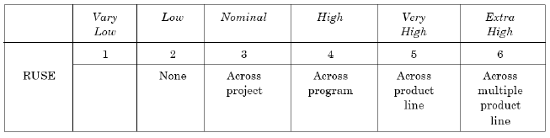
Required Reuse (RUSE)
  This early design model cost driver is same as its Post architecture Counterpart. The RUSE rating levels are (as per Table 16):

Slide 31
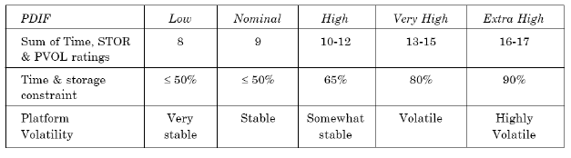
Platform Difficulty (PDIF)
  This cost driver combines TIME, STOR and PVOL of Post Architecture Cost Drivers.

Slide 32
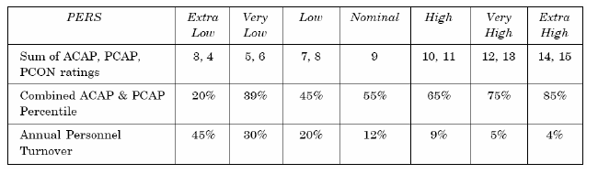
Personnel Capability (PERS) :
  This cost driver combines three Post Architecture Cost Drivers.
  These drivers are ACAP, PCAP and PCON.

Slide 33
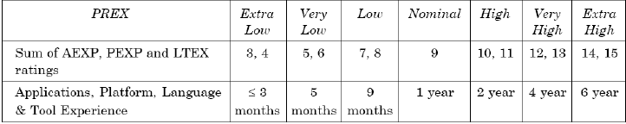
Personnel Experience (PREX) :
  This early design driver combines three Post Architecture Cost Drivers, which are AEXP, PEXP and LTEX.

Slide 34
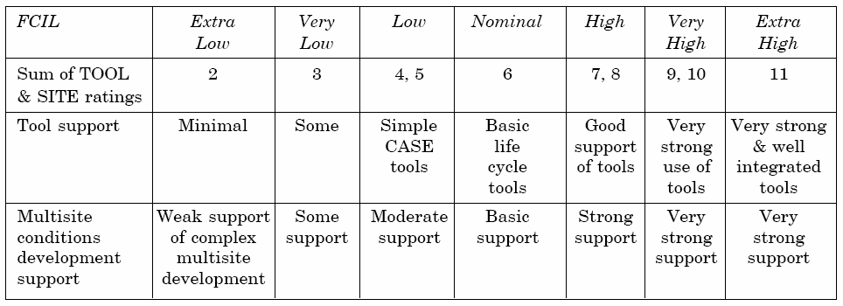
Facilities (FCIL):
  This depends on two Post Architecture Cost Drivers,which are TOOL and SITE.

Slide 35

Schedule (SCED)
  This early design cost driver is the same as Post Architecture Counterpart and rating level are given below.

Slide 36
The seven early design cost drivers are converted into numeric values with a Nominal value 1.0.
These values are used for the calculation of a factor called “Effort multiplier” which is the product of all seven early design cost drivers.

Slide 37
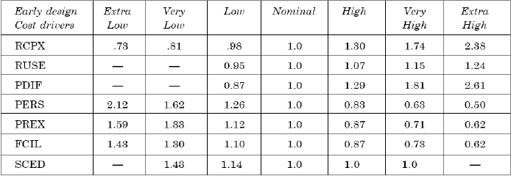
Early Design parameter

Slide 38

Note
The early design model adjusts the nominal effort using 7 effort multipliers(EMs).
Each effort multiplier (also called drivers) has 7 possible weights. These factors are used for the calculation of adjusted effort as given below:
PMadjusted effort may very even up to 400% from Pmnominal Hence PMadjusted is the fine tuned value of effort in the early design phase.

Slide 39
Example
A software project of application generator category with estimated 50KLOC has to be developed.
The scale factor (B) has low precedentness, high development flexibility and low team cohesion. Other factors are nominal.
The early design cost drivers like platform difficult (PDIF) and Personnel Capability (PERS) are high and others are nominal.
Calculate the effort in person months for the development of the project.

Slide 40
Solution
B = 0.91 + 0.01 * (Sum of rating on scaling factors for the project)
= 0.91 + 0.01 * (4.96 + 2.03 + 4.24 + 4.38 + 4.68)
= 0.91 + 0.01(20.29)
=1.1129
= 2.5 * (50)^{1.1129} = 194.41 Person months

Slide 41
Contd…
The 7 cost drivers are:-
  PDIF = high (1.29)
  PERS = high (0.83)
  RCPX = nominal (1.0)
  RUSE = nominal (1.0)
  PREX = nominal (1.0)
  FCIL = nominal (1.0)
  SCEO = nominal (1.0)

Slide 42
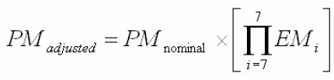
= 194.41 * [1.29 x 0.83)
= 194.41 x 1.07
= 208.155 Person months Software

Slide 43
Post Architecture Model

Slide 44
Post Architecture Model
The post architecture model is the most detailed estimation model and is intended to be used when a software life cycle architecture has been completed.
This model is used in the development and maintenance of software products in the application generators, system integration or infrastructure sectors.

Slide 45
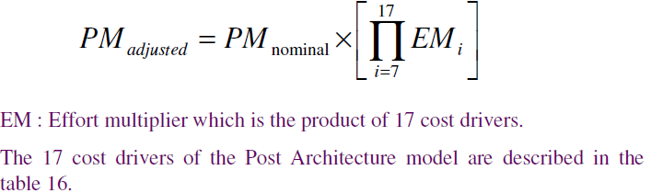
Post Architecture Model

Slide 46
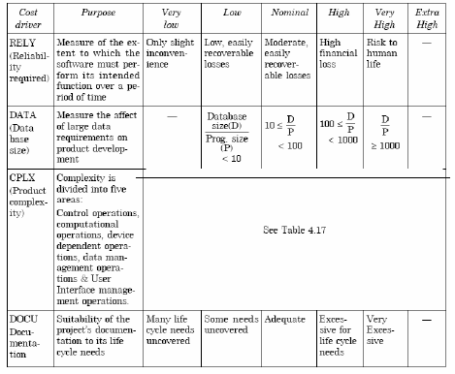
Post Architecture Cost Driver rating level summary

Slide 47
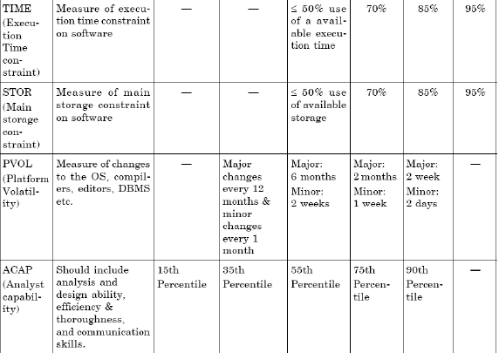

Slide 48
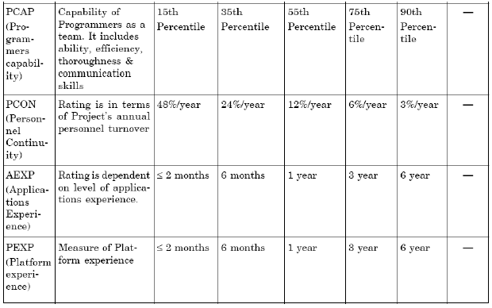
Post Architecture Cost Driver rating level summary

Slide 49
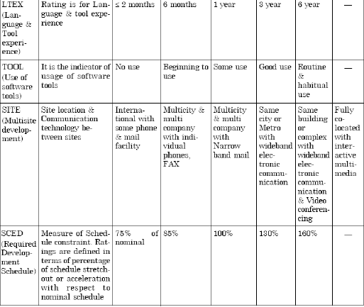
Post Architecture Cost Driver rating level summary

Slide 50
Product complexity is based on control operations, computational operations, device dependent operations, data management operations and user interface management operations.
The numeric values of these 17 cost drivers are used in the calculation of the product of efforts i.e., effort multiplier (EM).
Hence PM adjusted is calculated which will be a better and fine tuned value of effort in person months.

Slide 51
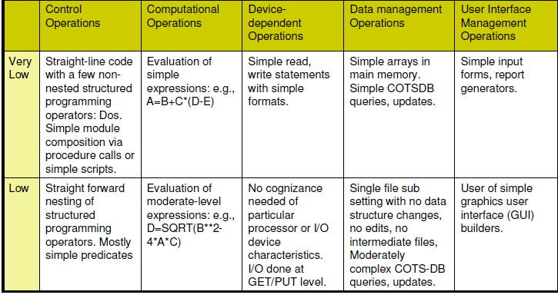
Module complexity ratings

Slide 52
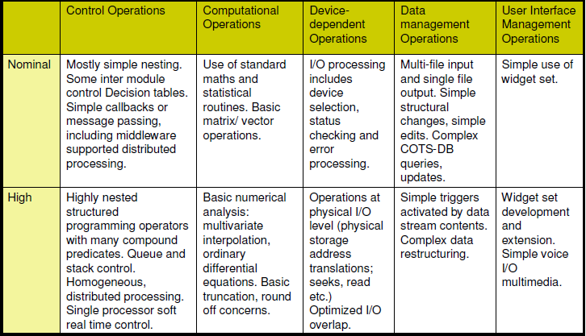
Module complexity ratings

Slide 53
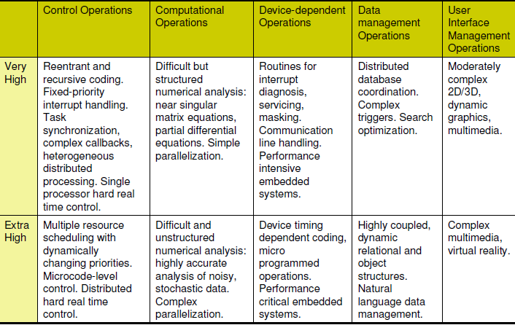
Module complexity ratings

Slide 54
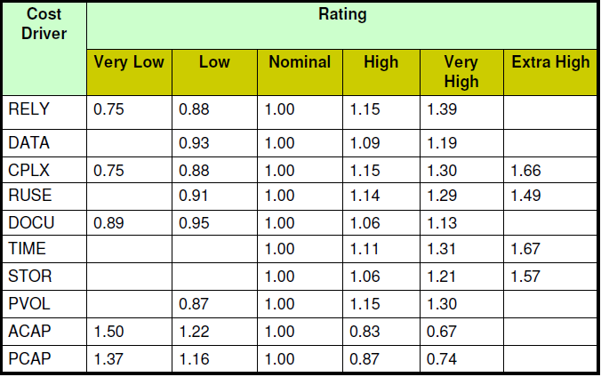
Cost Drivers

Slide 55
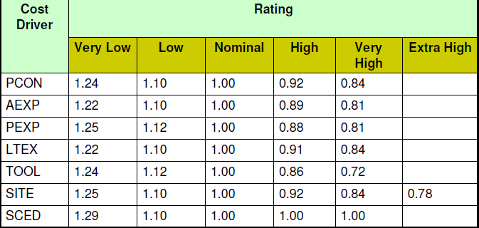
Cost Drivers
17 Cost Drivers

Slide 56
Example: Consider Previous Project
Size and scale factor(B) are the same.
The identified 17 Cost drivers are high reliability (RELY),very high database size (DATA), high execution time constraint (TIME), very high analyst capability (ACAP), high programmers capability (PCAP).
The other cost drivers are nominal.
Calculate the effort in Person-Months for the development of the project.

Slide 57
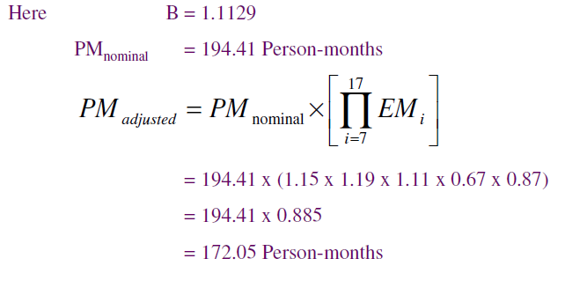
Solution

